Slide 1
Dual Thermal Heated Rubidium Optical Cell
Author: James Deromedi
Mentor: Jonathon Newport

Slide 2



Why
Technical
Analysis

Slide 3
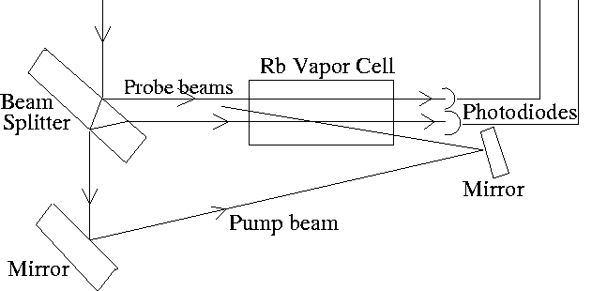
Exploring
Nature of PID Algorithms
Basics of Op-Amps
Engineering
Industrial Grade Hardware
Academic Research Potential
High Current Applications
Rubidium Optical Cell within a Laser device

Slide 4
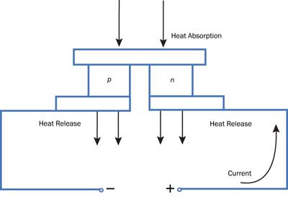
Terminology
Rubidium [Rb]
Highly reactive to air and water
Must be kept at 100±0.5 Celsius
PID
Proportional
Integral
Derivative
TEC
Thermoelectric Cooler
TEC Schematic
Notes:
P: How aggressively the algorithm reacts to the current error
The greater the error, the greater the algorithm reacts
I: How the algorithm reacts to error over time
The longer the error isn’t zero, the greater the algorithm reacts
D: How the algorithm deals with a change in the set point and trys to flatten the trajectory to a horizontal line

Slide 5
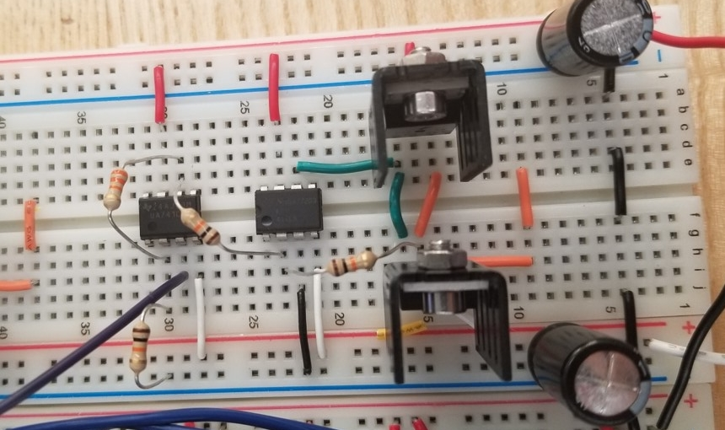
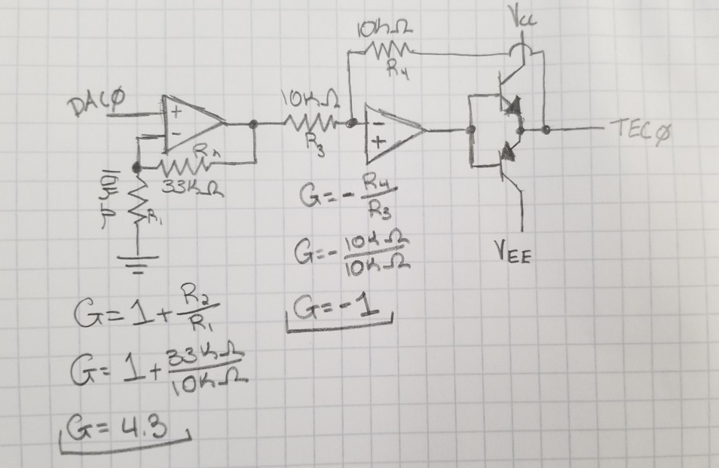
Notes:
Ability to add variability to each part

Slide 6

Dynamically Tuning

Slide 7
Thank You
Any Questions?

